Slide 1
WELCOME!!!!!!!!!
Engineering Hands-on!

Slide 2
What is Engineering?

Slide 3
The Engineering Design Process

Slide 4
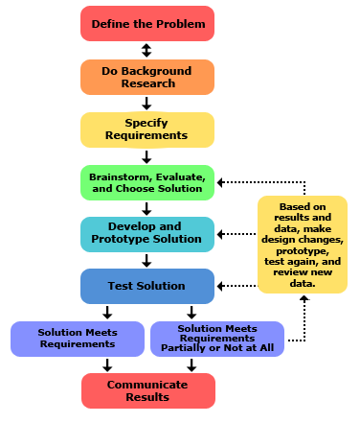

Slide 5
Safety & Guidelines
Use common sense
Get to know the space
Organization is key - put things where they’re supposed to be
Use proper protection when needed (safety glasses, gloves, etc)
Always power off before working on something.
Watch before connecting anything together. You may be shorting the circuit.
Check your power supply is at the correct voltage before connecting it
Ask if you’re not sure about anything

Slide 6
Current - Voltage - The water analogy
Voltage - the “pressure” forcing electricity to move
Current - how much electricity is moving
Voltage is analogous to a water tap
Current is analogous to how much water is flowing.

Slide 7
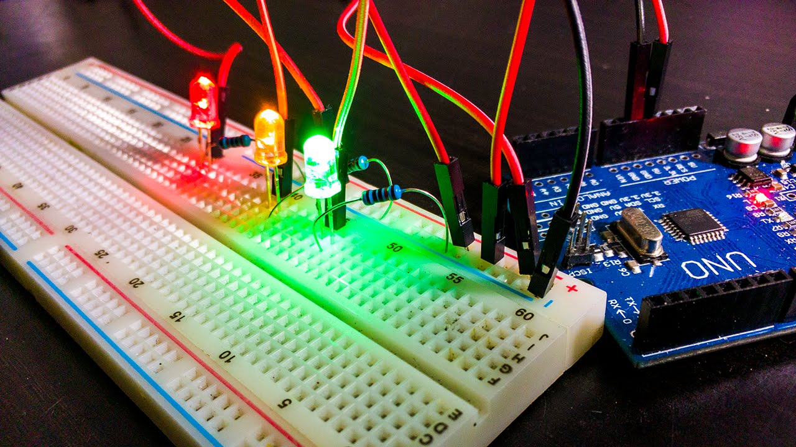
Basic tools in electrical engineering
Power supply
Wires & breadboard
Switches
Resistors
Potentiometer
Capacitors
Inductors
Diodes
LED
Multimeter
Oscilloscope

Slide 8
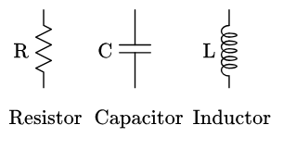
Working Principle
The water analogy:
Resistor (R)
Capacitor (C)
Inductor (L)

Slide 9
Activity
Reading component values.
Practice using a multimeter and oscilloscope

Slide 10
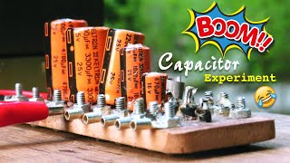
Caution: Watch the polarity of your electrolytic capacitors

